Slide 1
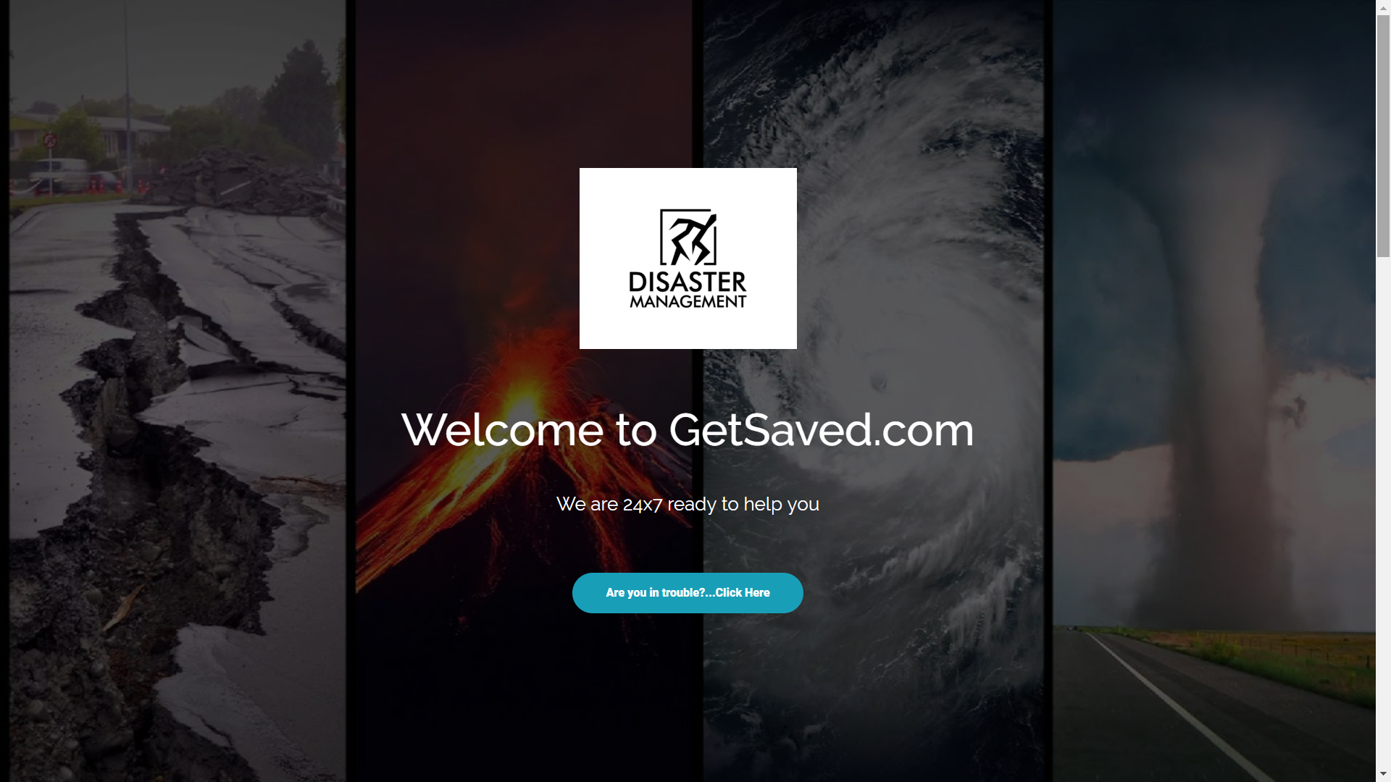




Slide 2

Get-Saved.com
(Also in Android app)
User Panel
Admin Panel
Information Page
Disaster Form
(With exact latt. & long.)
Weather
Report
Control Panel
(User Info)
Rescue Team
Area (Ping Location)
Women Safety page
Women Safety Form page (GPS )
Our Rescue Team
Nearest Police Station
Nearest Hospital
Fire Brigade

Slide 3
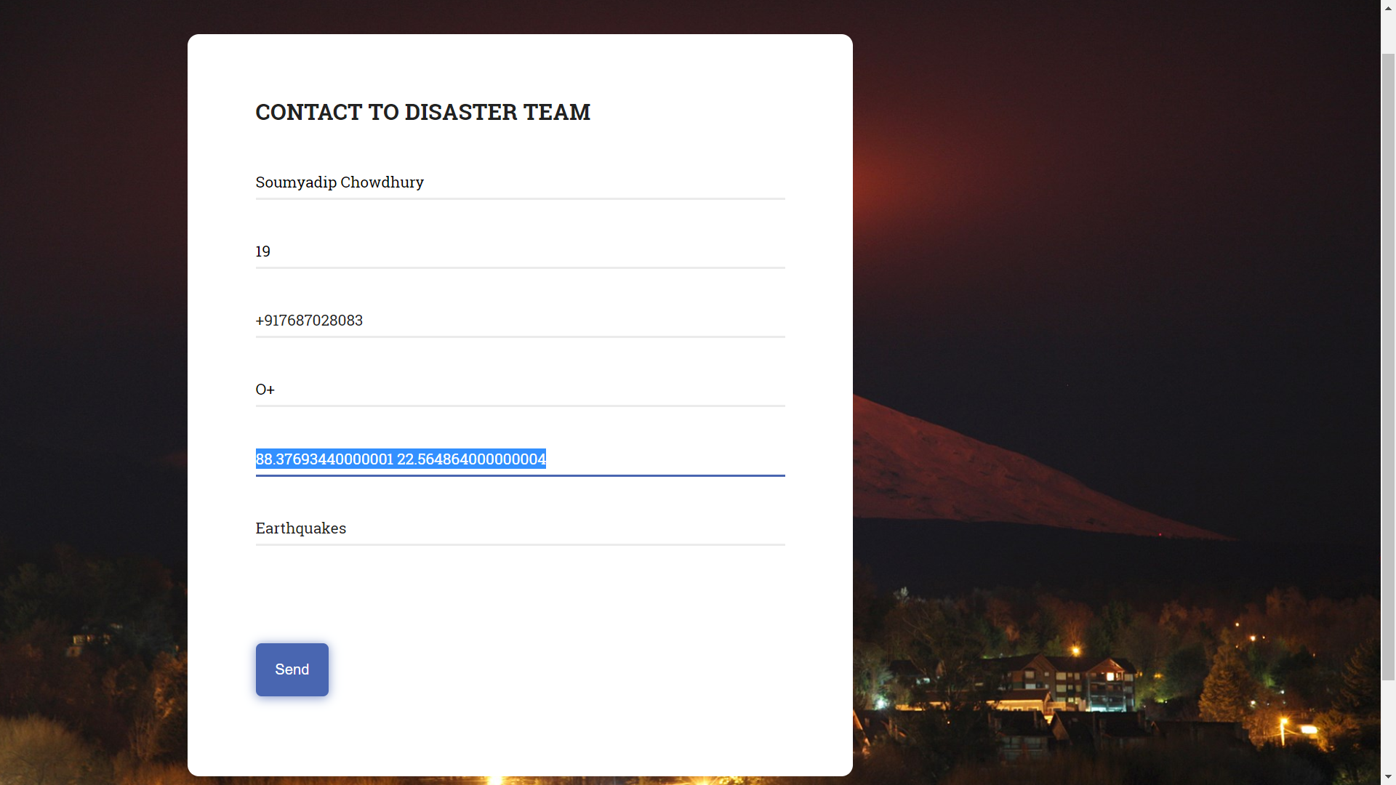
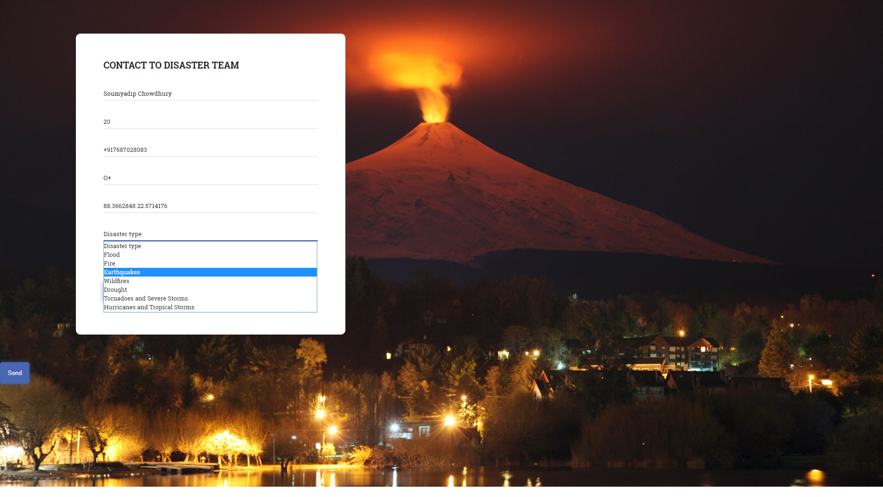

Slide 4
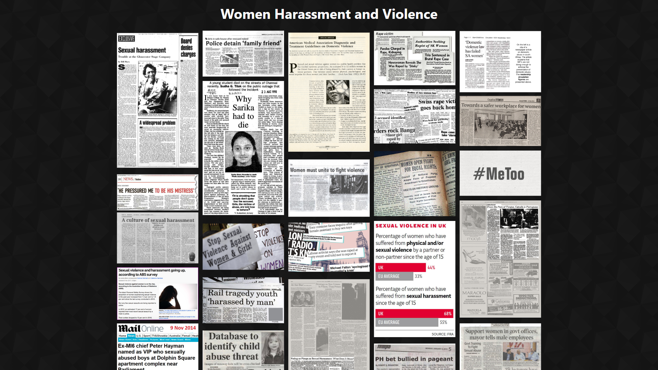

Slide 5


Slide 6
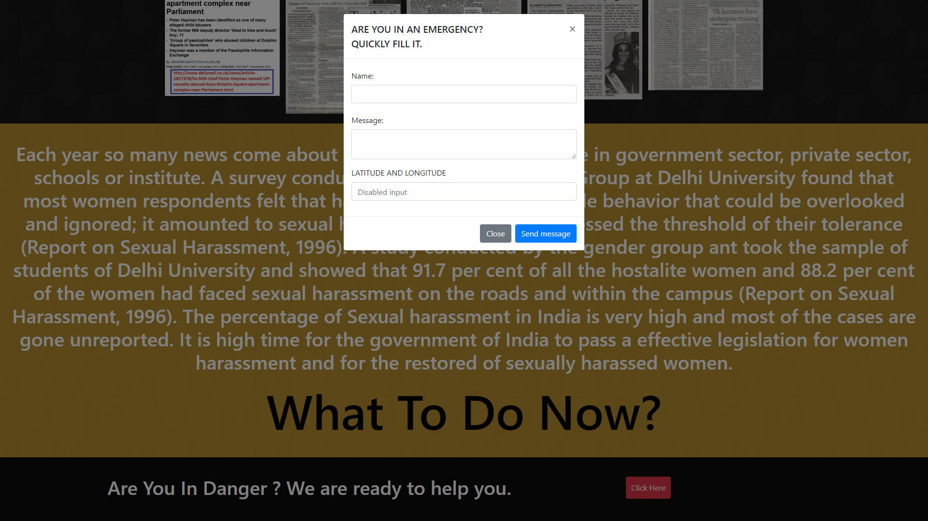

Slide 7
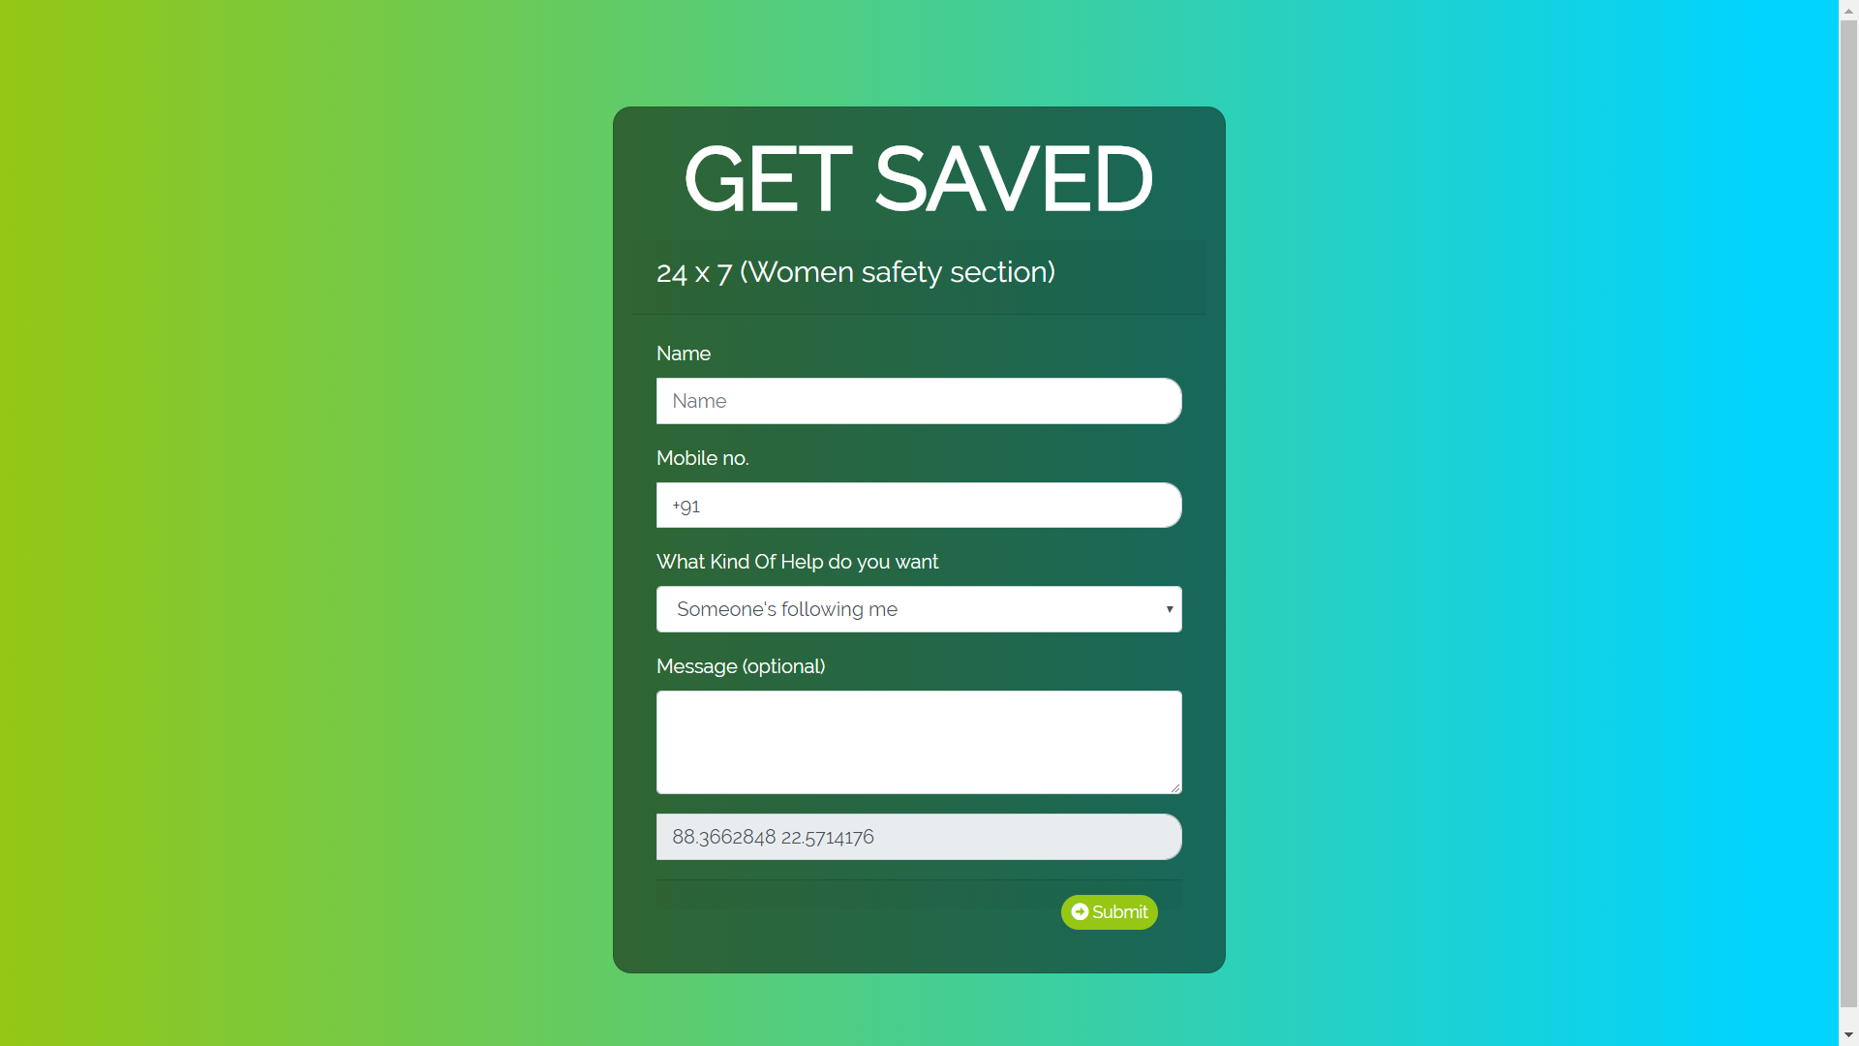
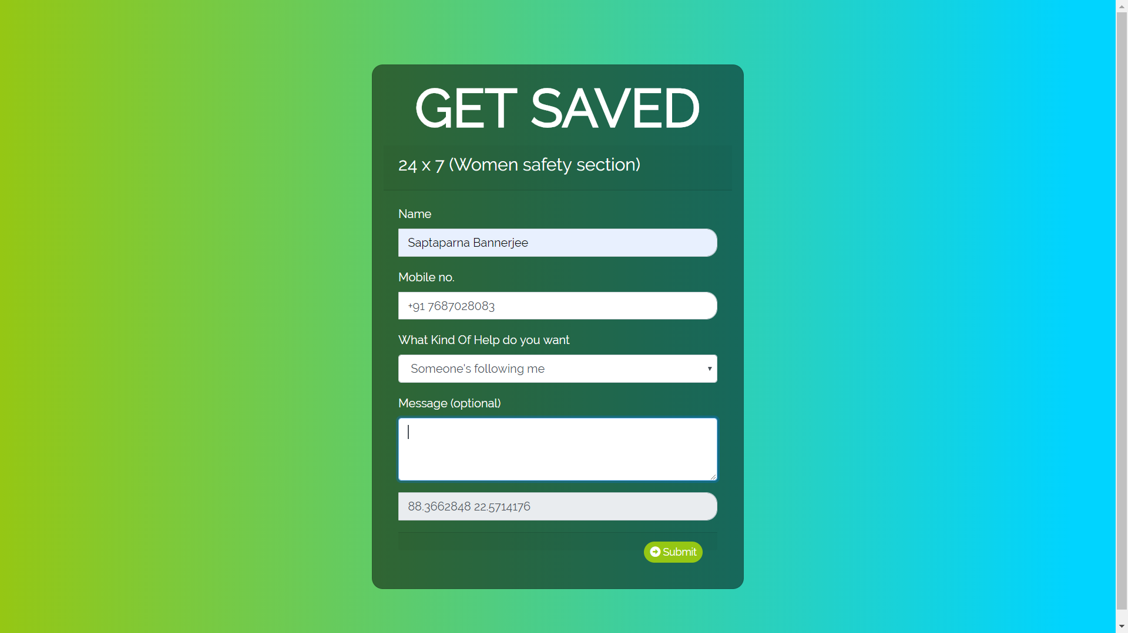

Slide 8
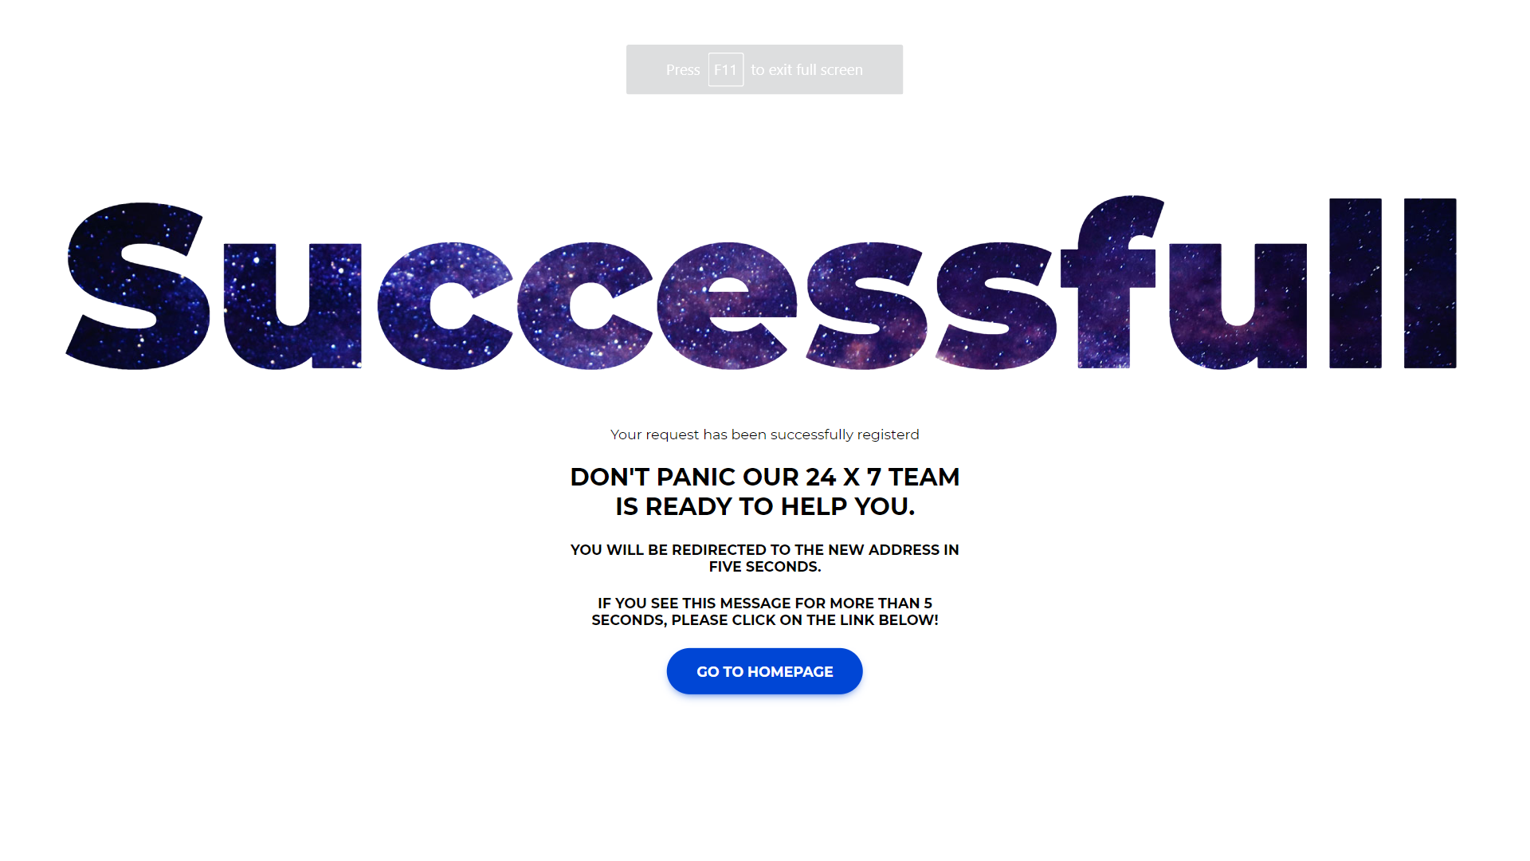

Slide 9
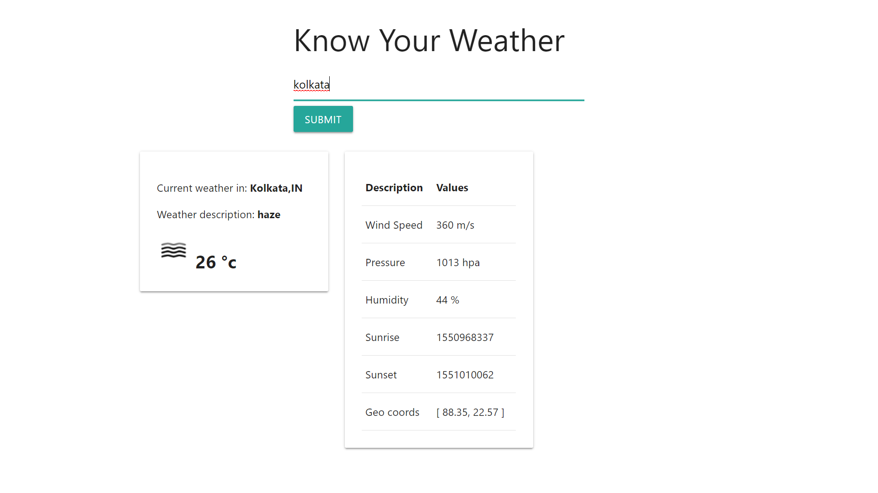

Slide 10
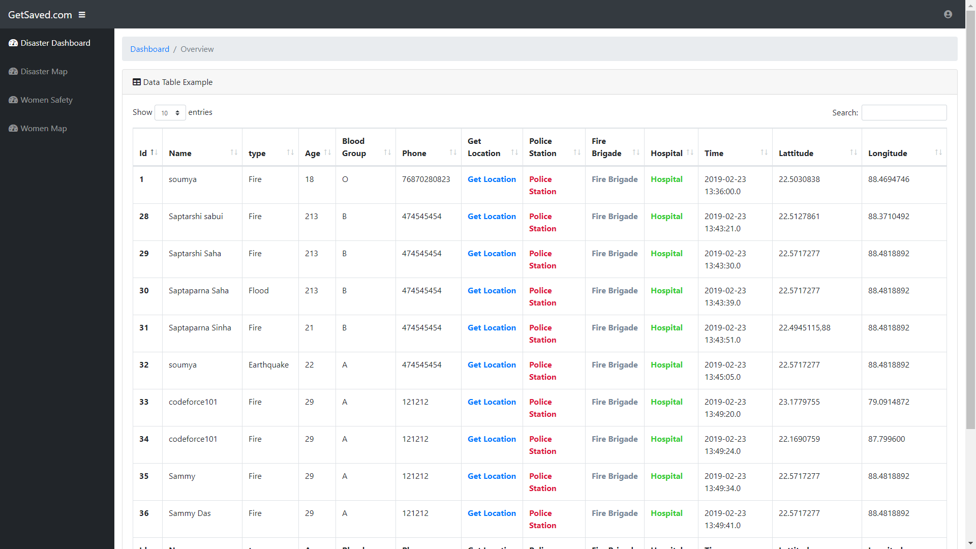

Slide 11
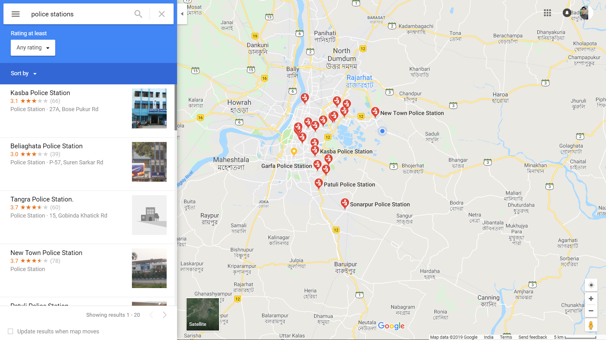

Slide 12
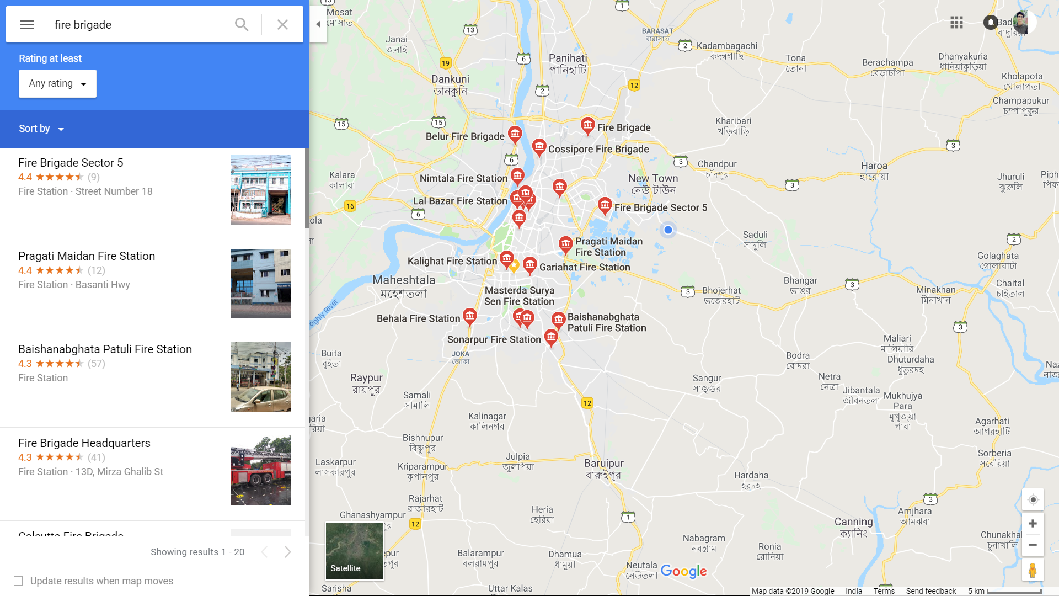

Slide 13
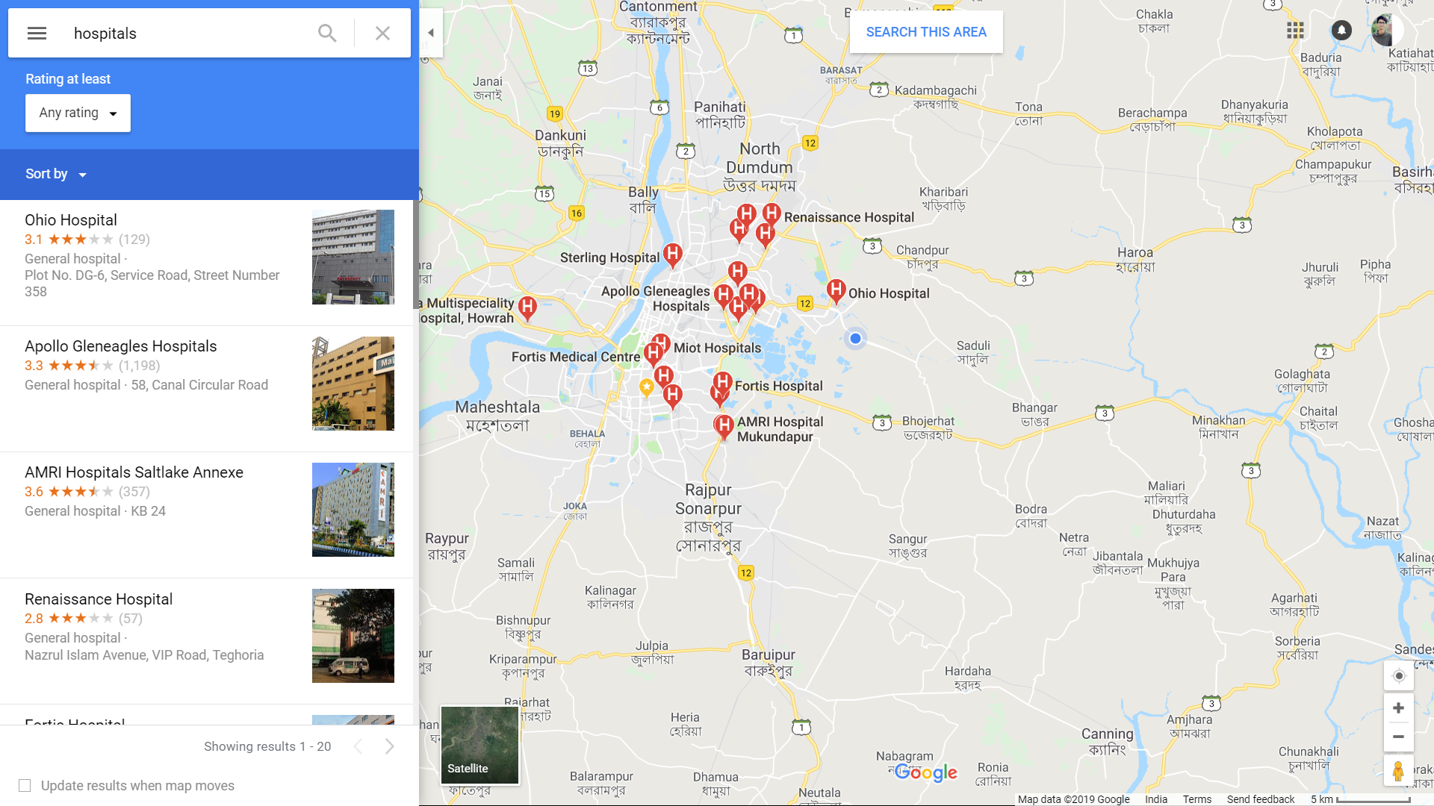

Slide 14
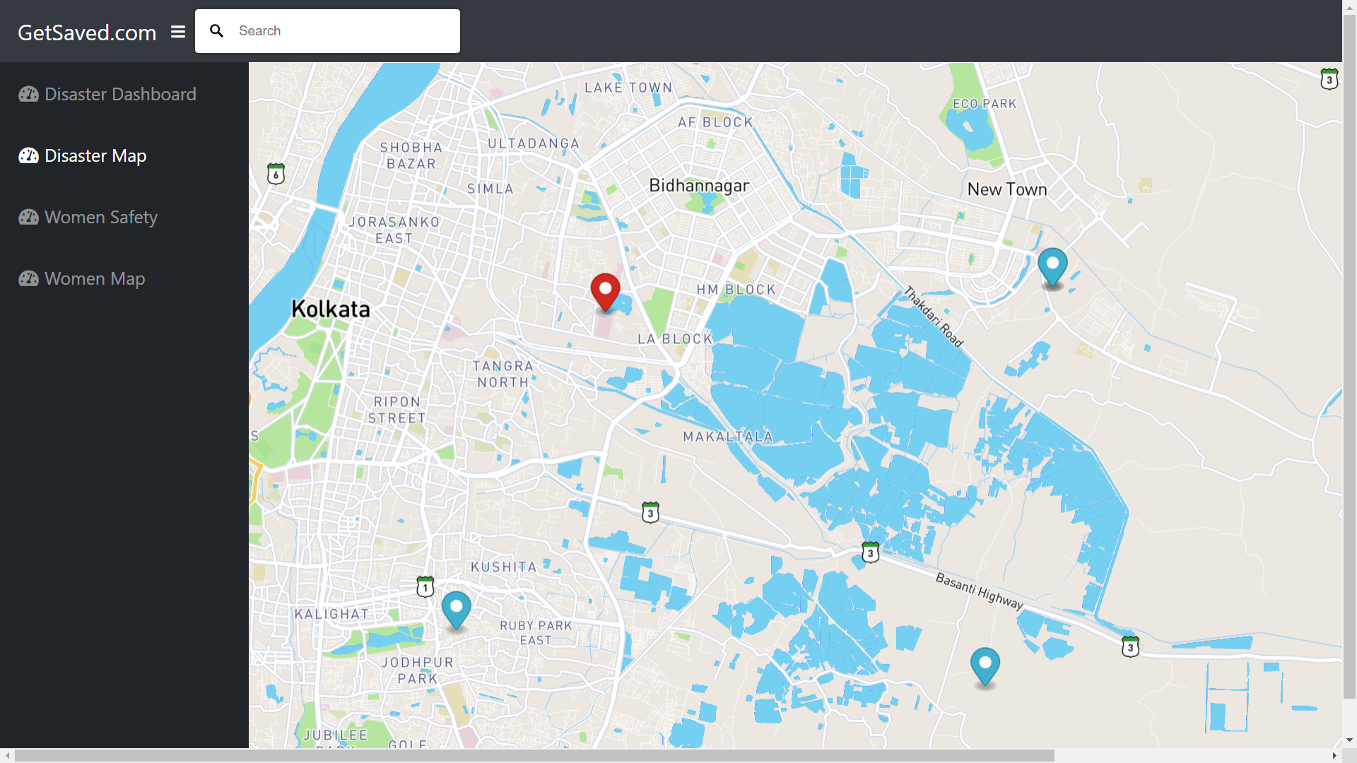

Slide 15
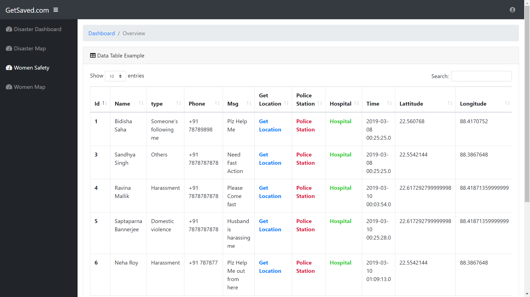
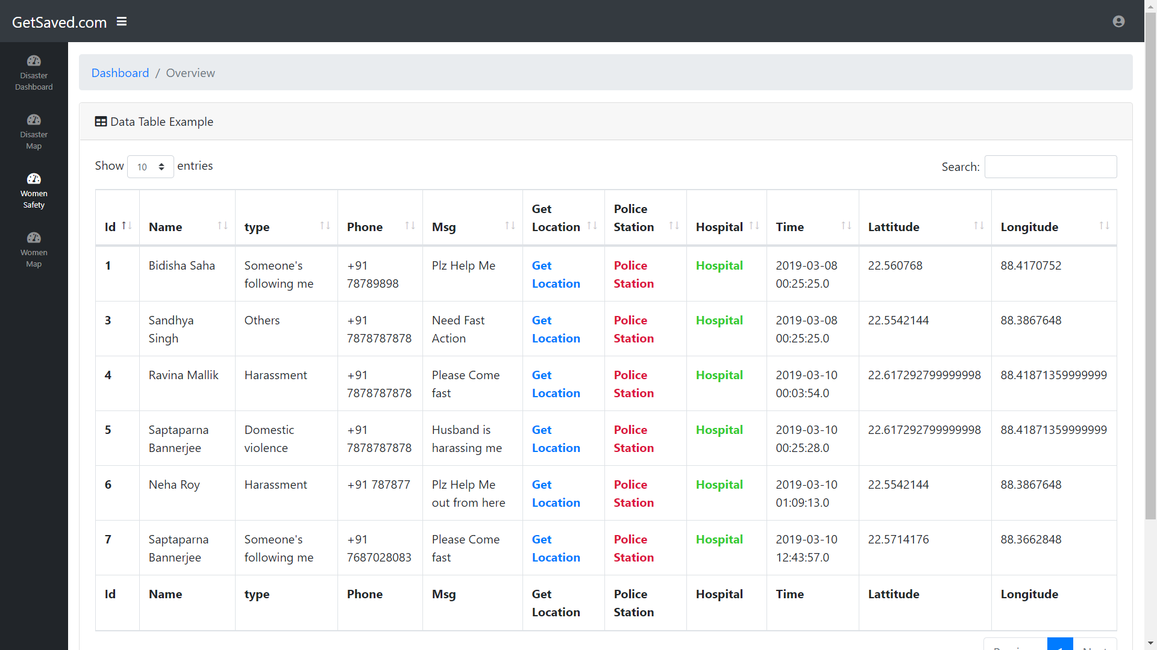

Slide 16
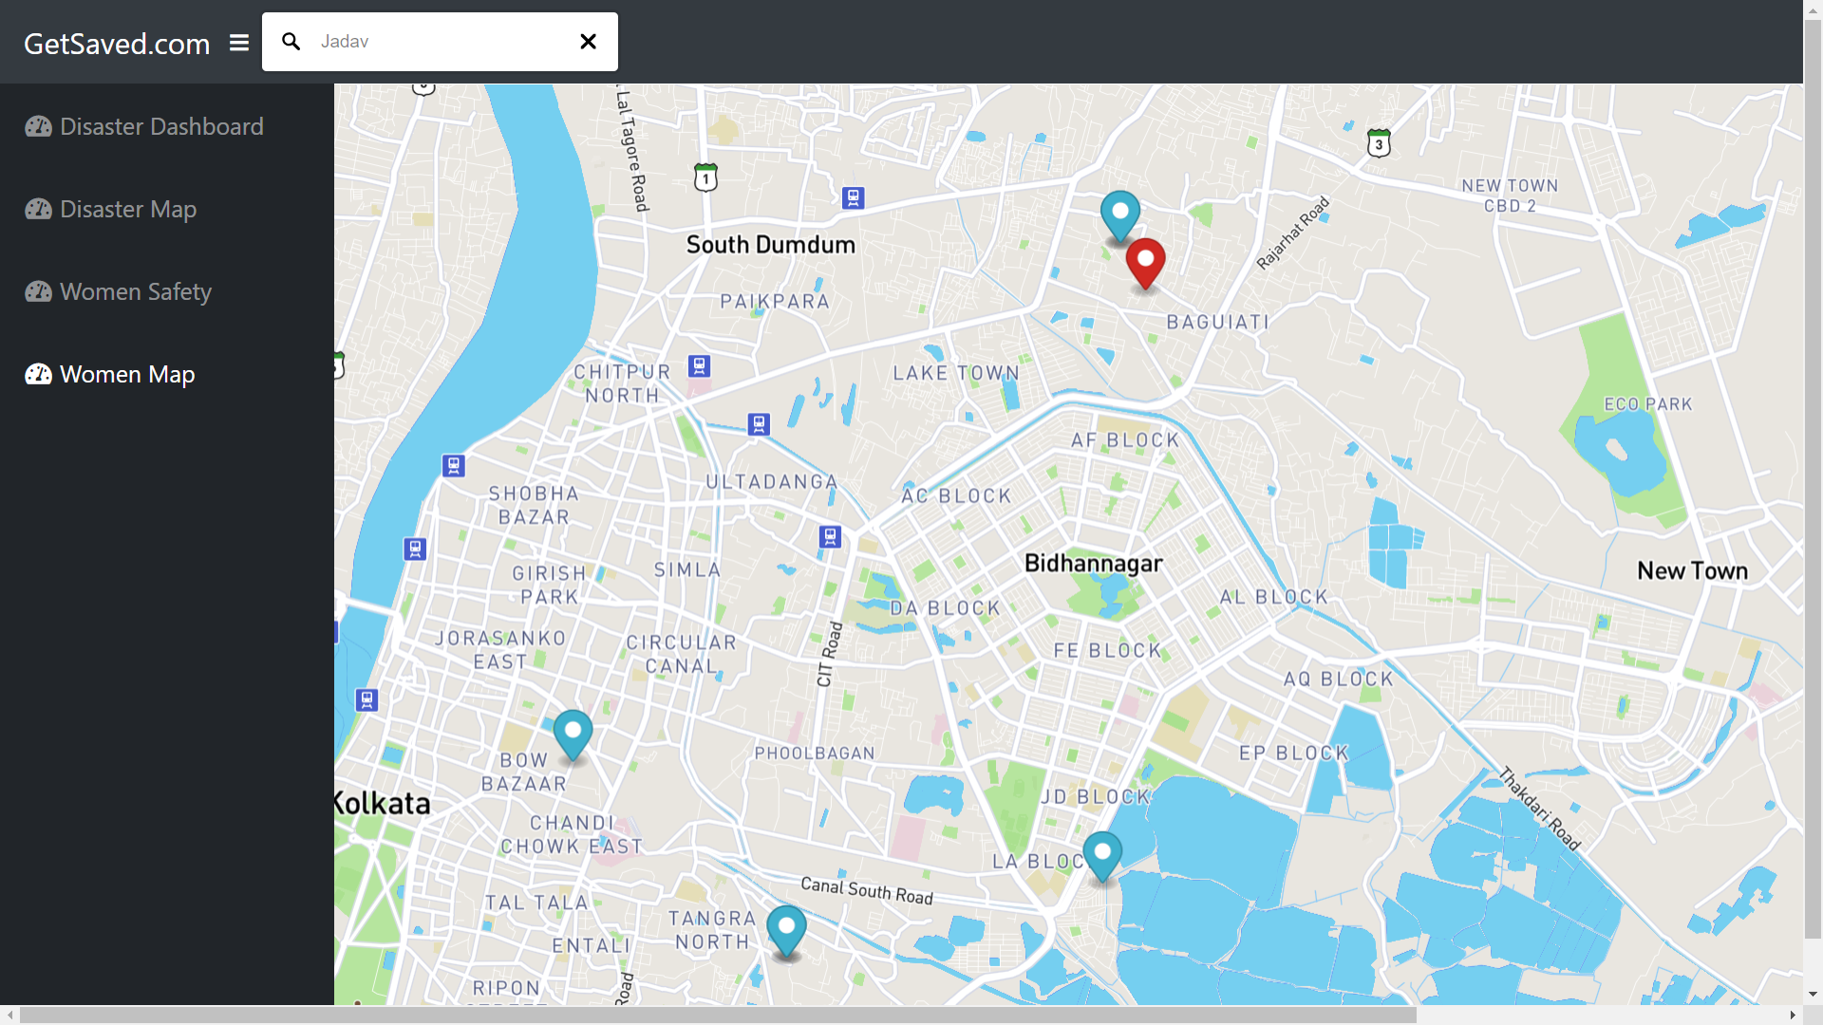
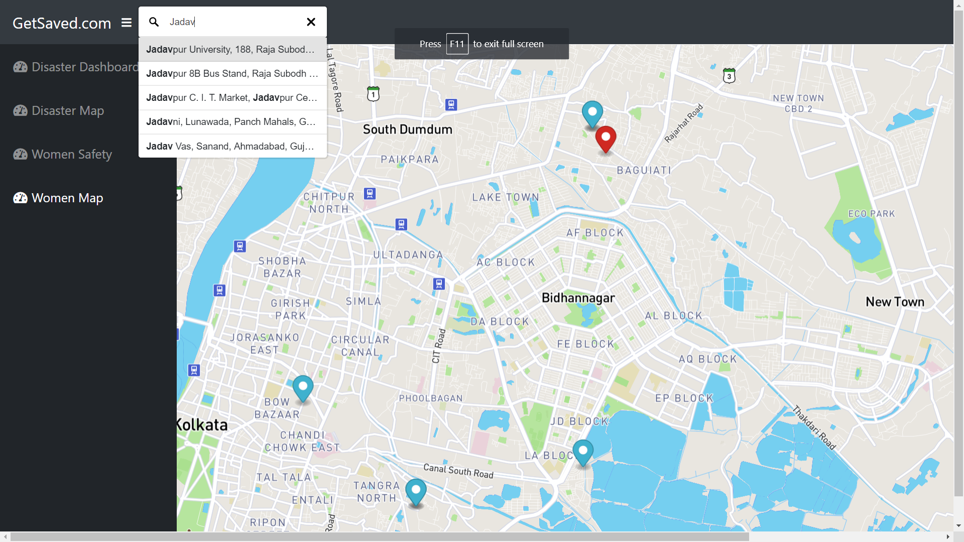

Slide 17


Slide 18
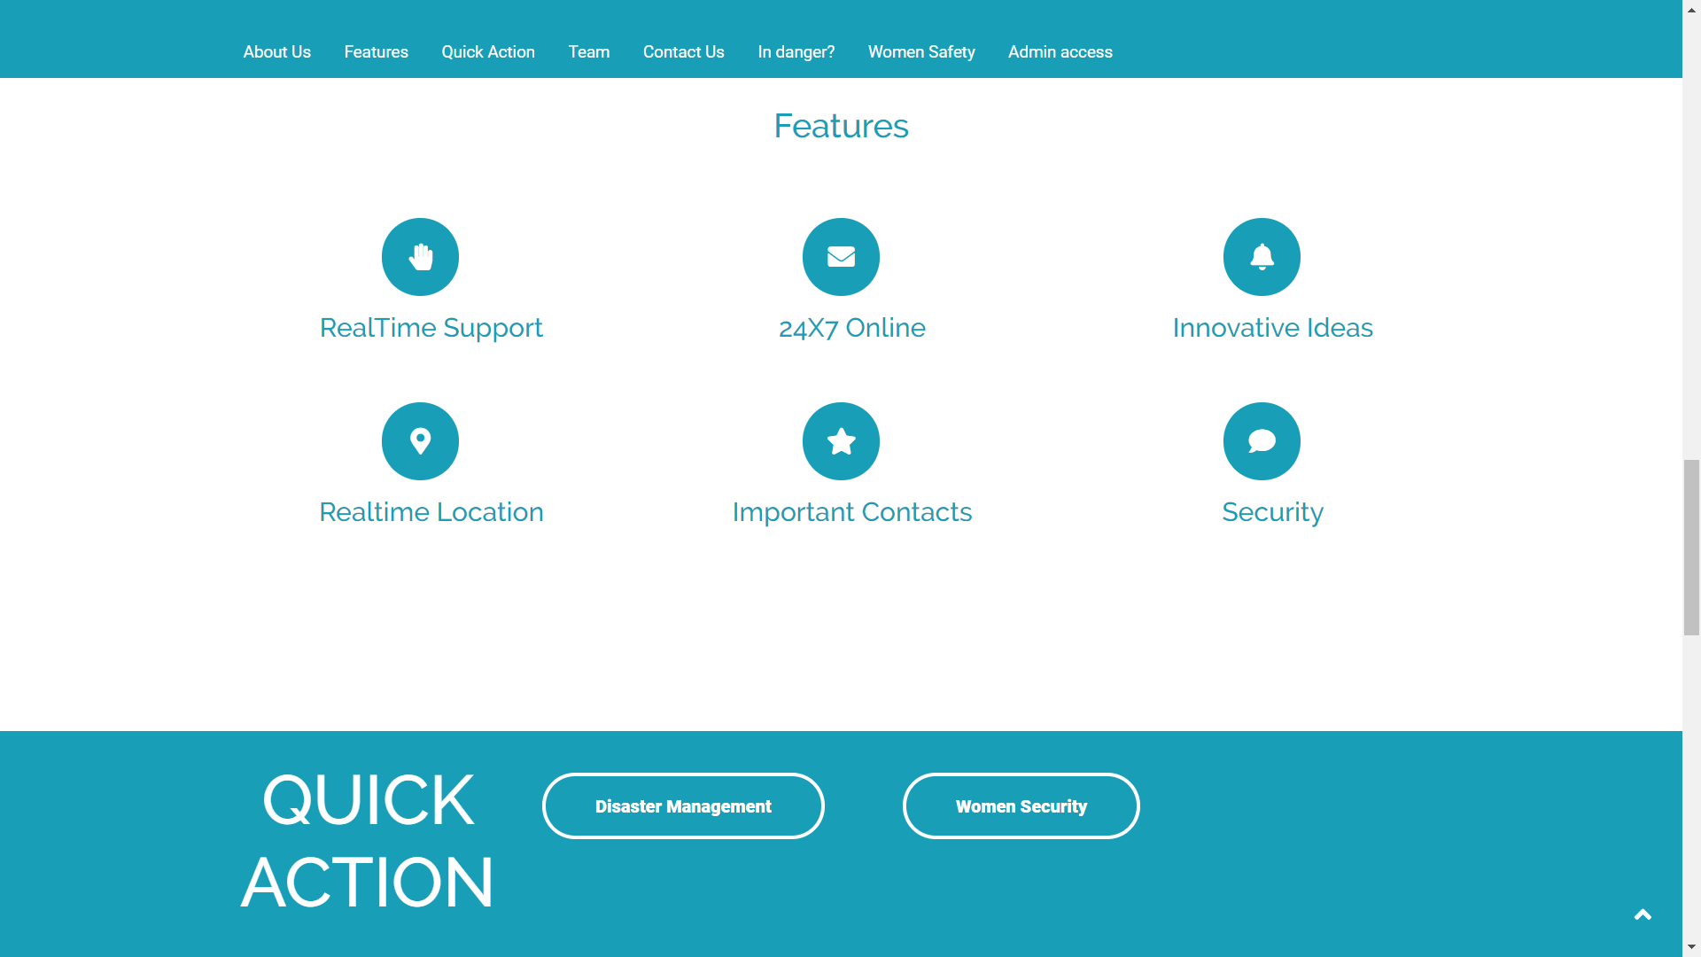

Slide 19
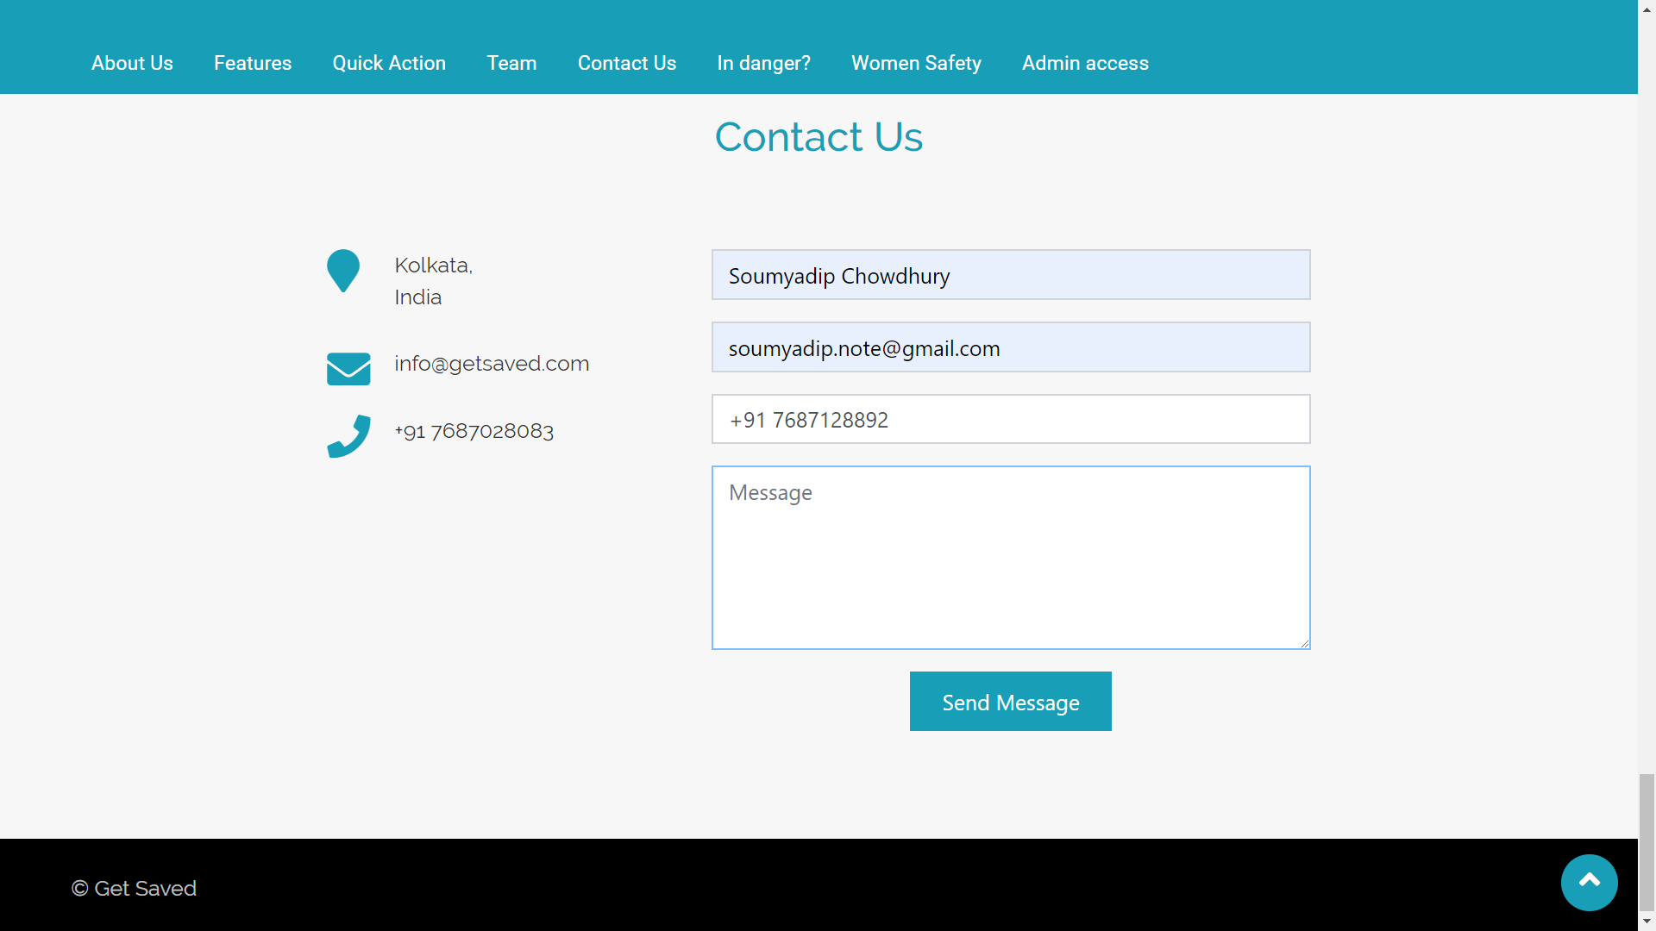

Slide 20
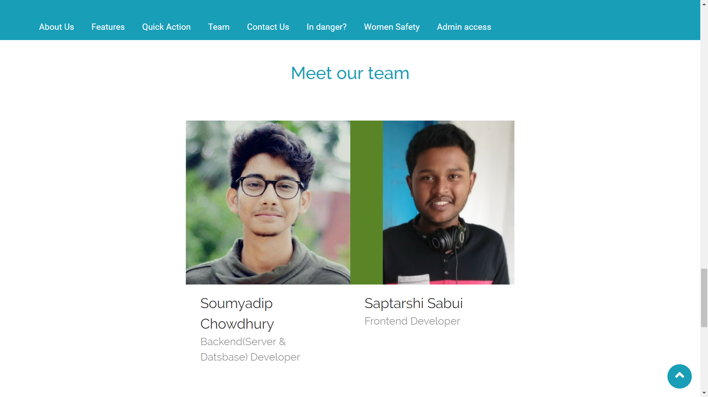

Slide 21
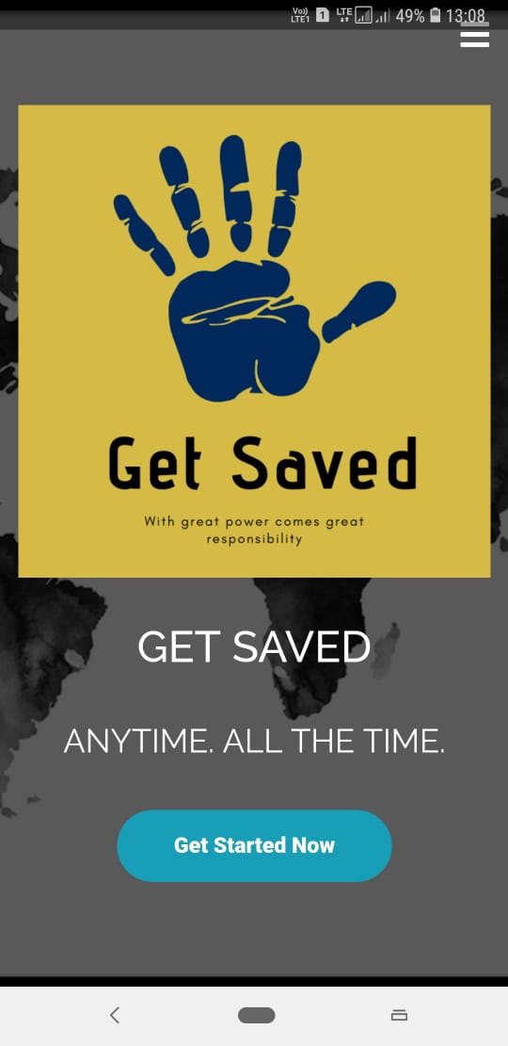
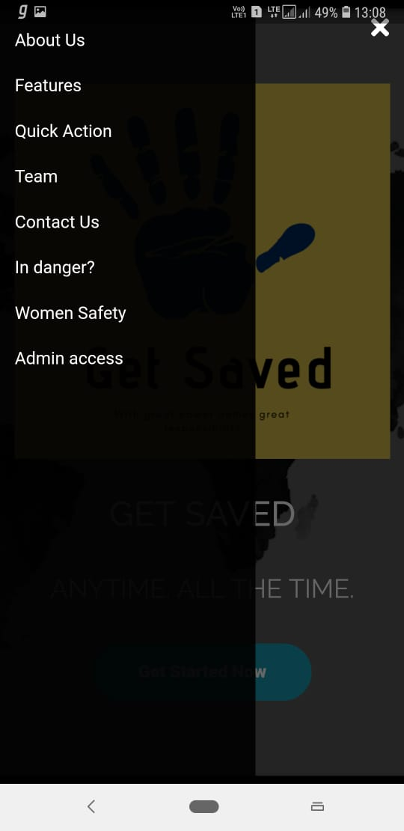
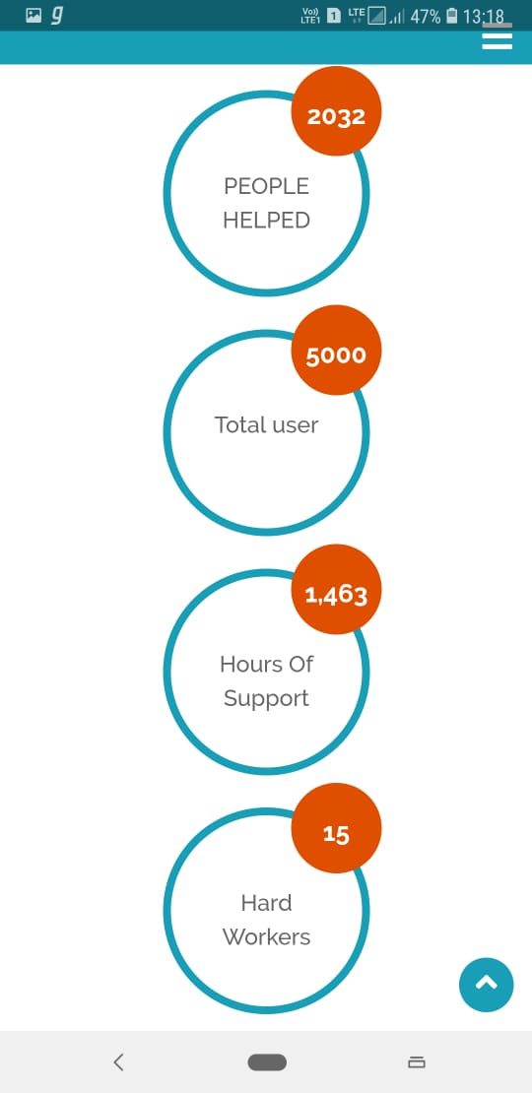
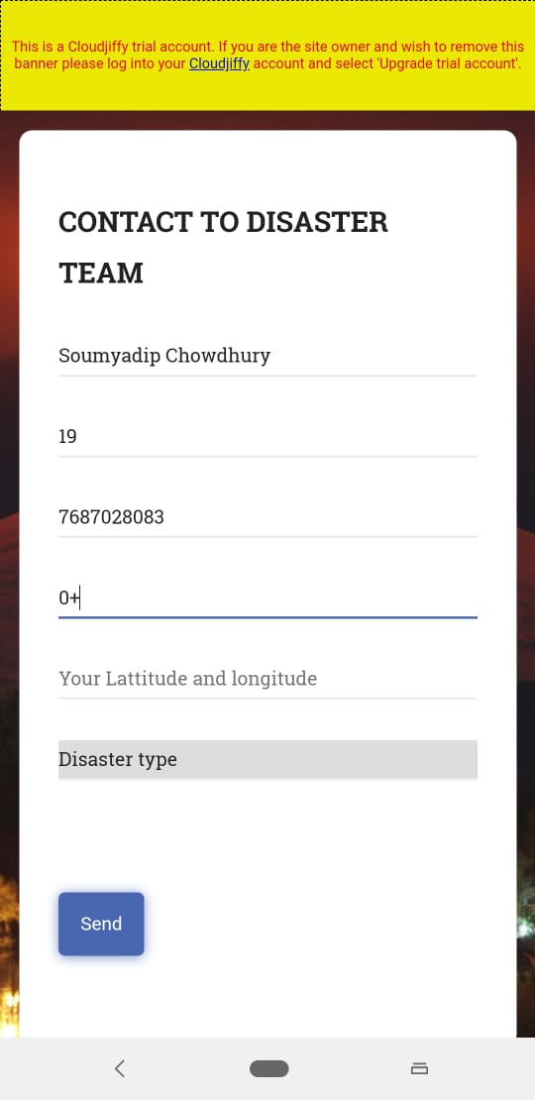

Slide 22
THANK YOU
GetSaved.com (Website & Android)
Cloud Deployment- http://get-saved.cloudjiffy.net
(Using HTML5, CSS, BOOTSTRAP, JAVASCRIPT, JSP, SERVLET, JSTL, MYSQ, API, Geo-Location,Andoid)
Soumyadip Choudhury & Saptarshi Sabui
SparkHack

